Slide 1





Does Transliteration Help Multilingual Language Modeling?
Ibraheem Muhammad Moosa, Mahmud Elahi Akhter, Ashfia Binte Habib
EACL 2023 Paper ID: 433
Notes:
Hello everyone. My name is Mahmud Elahi Akhter. Today I will be presenting our work to you. Does transliteration help multilingual language modeling?

Slide 2
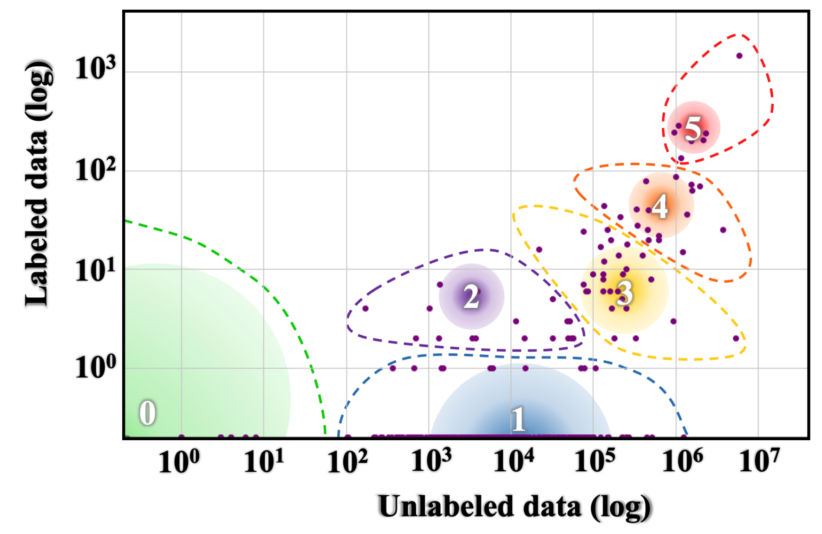
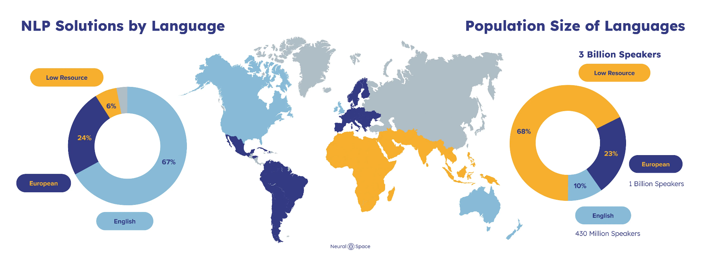
Motivation & Background
Open Problems
Resource disparity between Low Resource Languages and High Resource Languages
Diversity and Inclusivity of Low Resource Language tasks
Language resource distribution¹.
Issues for Low Resource Languages
Lack of large pretraining corpus
Lack of diverse evaluation dataset
Diversity and inclusivity disparity²
The State and Fate of Linguistic Diversity and Inclusion in the NLP World, Joshi et al. (2020)
Challenges in using NLP for low-resource languages and how NeuralSpace solves them, Felix Laumann (2022)
Notes:
We have seen impressive advances in many NLP tasks in recent times. These advances have been primarily led by the availability of large representative corpora and improvement in the architecture of large language models. For instance, we have seen the popularity of ChatGPT in the last few months and how its impact is being felt almost everywhere.
While improving model architectures, training methods, regularization techniques, etc., can help advance the state of NLP in general, when it comes to low resource languages, these advances are not as prominent. Even though multilingual language models have proved some form of improvements, there are still two major open problems when it comes to low resource language modeling.
These are, the resource disparity between low resource languages and high resource languages. For instance, this disparity leads to lack of large pre training corpus.
We can see here from Joshi et al, the disparity of data availability between low resource and high resource languages. Here the size and color of a circle represent the number of languages and speakers respectively in each category. Colours (VIBGYOR) represent the total speaker population size from low (violet) to high (red).
On the other hand, we also lack the diversity and inclusivity of low resource language tasks. Which leads to lack of diverse evaluation datasets in low resource language modeling. This is harder to solve compared to collecting pre-training corpus as this requires more curation. Nevertheless, we can do something about lack of pretraining corpus.

Slide 3
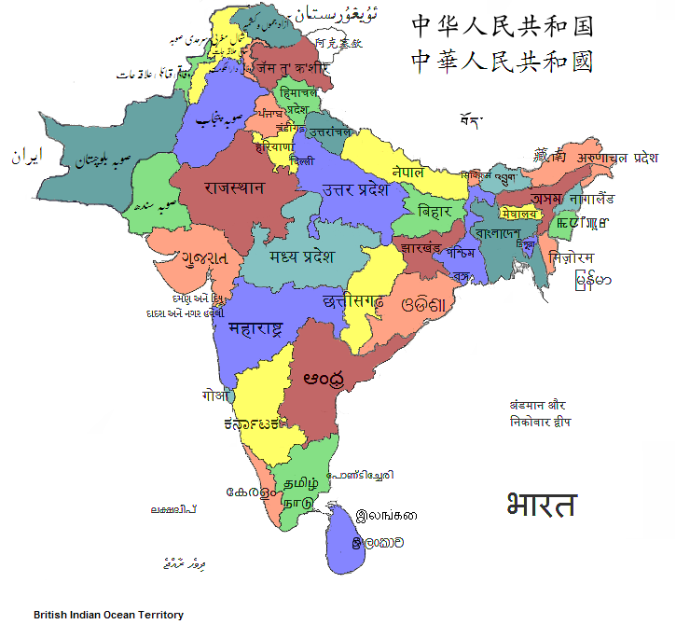


Motivation & Background
Additional obstacles for Low Resource Language
Script barrier leads to poor lexical overlap ¹
Poor Tokenization leads to increase in unknown
tokens ²
Proposed Solution
Grapheme-to-phoneme (G2P)
Transliteration
Script diversity in South Asia³.
Pushing the Limits of Low-Resource Morphological Inflection, Anastasopoulos and Neubig (2019):
UNKs Everywhere: Adapting Multilingual Language Models to New Scripts, Pfeiffer et al.(2021)
en.wikipedia.org/wiki/Languages_of_South_Asia#/media/File:States_of_South_Asia.png
Notes:
Additionally, there are further obstacles for low resource languages. Many low resource languages use non-Latin writing scripts. As a result they have poor lexical overlap with high resource languages. So it becomes difficult to share knowledge from high resource languages to low resource languages. Also when it comes to tokenization, low resource languages also suffer from an increased number of unknown tokens. For example, we can see the script diversity of south asia. Even though all evolved from Brahmi scripts.
Nevertheless, there are two workarounds of solving these issues. These are grapheme to phoneme methods and transliteration methods. In this work, we have explored the transliteration method for the languages in the Indo Aryan and Dravidian language families.

Slide 4
Case for Translitertion
Devanagari भारत
Bengali ভারত
Telugu భారత
Benefits of Transliteration?
Gujarati ભારત
bhārata
Tamil பாரத
Transliteration collapses multiple scripts into a single script
Improves lexical overlap
Gurmukhi ਭਾਰਤ
Oriya ଭାରତ
Reduces number of token
Kannada ಭಾರತ
Malayalam ഭാരത
However..
Devanagari शान्ति
Bengali শান্তি
Telugu శాన్తి
Does transliterating input scripts improve performance of multilingual language models?
Given it does, is this improvement statistically significant?
Does a model trained on transliterated script learn better representation?
Gujarati શાન્તિ
śānti
Tamil ஶாந்தி
Gurmukhi ਸ਼ਾਨ੍ਤਿ
Oriya ଶାନ୍ତି
Kannada ಶಾನ್ತಿ
Malayalam ശാന്തി
Notes:
So let's see the potential benefits of transliteration. First of all transliteration collapses multiple scripts into a single script. For example, we can see the word india in 9 different scripts which map to the single script bharata.
Transliteration also improves lexical overlap. We can see this from another example. The word peace has the same latin representation for 9 different languages. This has a further positive impact. That is this in practice reduces the number of tokens per word.
So transliteration seems to work wonders. However, we know there’s no free lunch. Therefore, we wanted to see if transliteration indeed improved the performance of multilingual language models.
If it did, then whether it was statistically significant or not. And finally, whether the transliteration models learned better representation.
From now on, we will refer to the transliteration model as uni-script and the control model as multi-script.

Slide 5
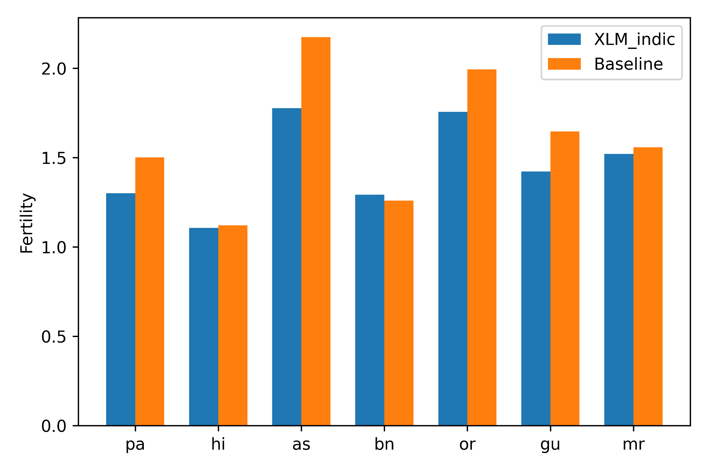
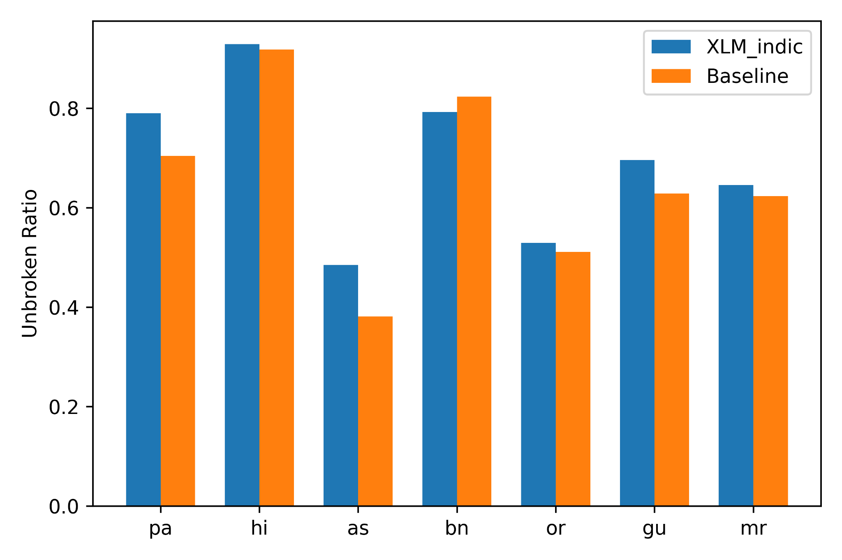
Results: Tokenization Quality
Transliteration Reduces number of token
Average number of tokens per word
Ratio of words unbroken by the tokenizer
Notes:
From results we can see that transliteration indeed reduces the number of tokens and improves tokenization quality. This is more prominent for low resource languages. For instance, if we are to see the average number of tokens per word, low resource languages have a much lower fertility score for the uni-script model compared to the multi-script model.
We can see a similar result for the ratio of words unbroken by the tokenizer.

Slide 6
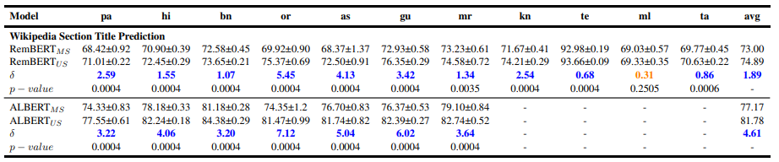
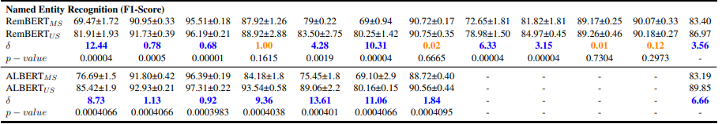
Results: Performance analysis
Orange indicates the multi-script and uni-script models are equal and blue indicates the uni-script model is better
On average transliteration improves performance of multilingual language models.
It improves the performance of low resource languages more compared to high resource languages
It does not deteriorate the results of low resource languages
Notes:
In performance analysis of uni-script and multi-script models we see that low resource languages have much better results for uni-script models compared to multi-script models. On the other hand, transliteration does not hurt the performance of models as evident from some of the NER results shown in orange. Statistically, both models perform similarly for this task and languages.
For example, in NER, the performance improvement of Punjabi and Gujarati, two low resource languages, for remBERT is 12.44 and 10.31 respectively. We can see similar trends for the ALBERT model also with Punjani having an improvement of 8.73 and Gujarati improving 13.61 points.

Slide 7
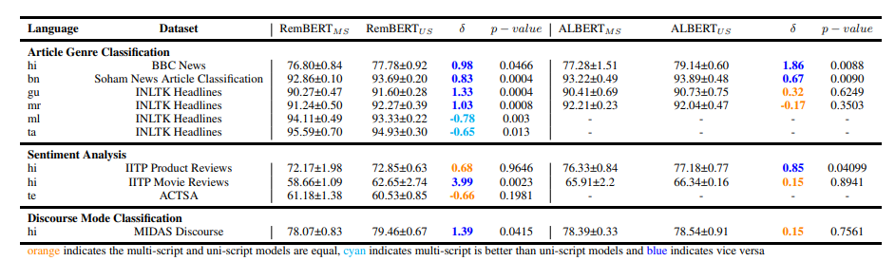
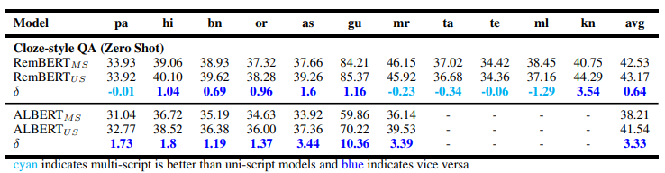
Results: Performance analysis
Orange indicates the multi-script and uni-script models are equal, cyan indicates multi-script is better than uni-script and blue indicates vice versa

Slide 8
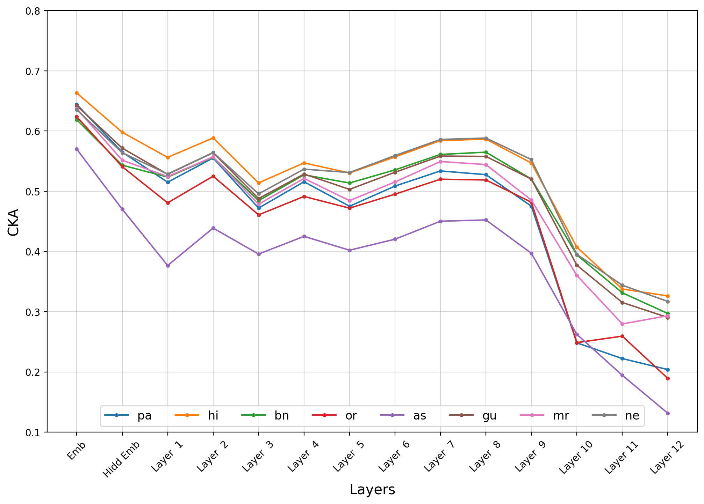
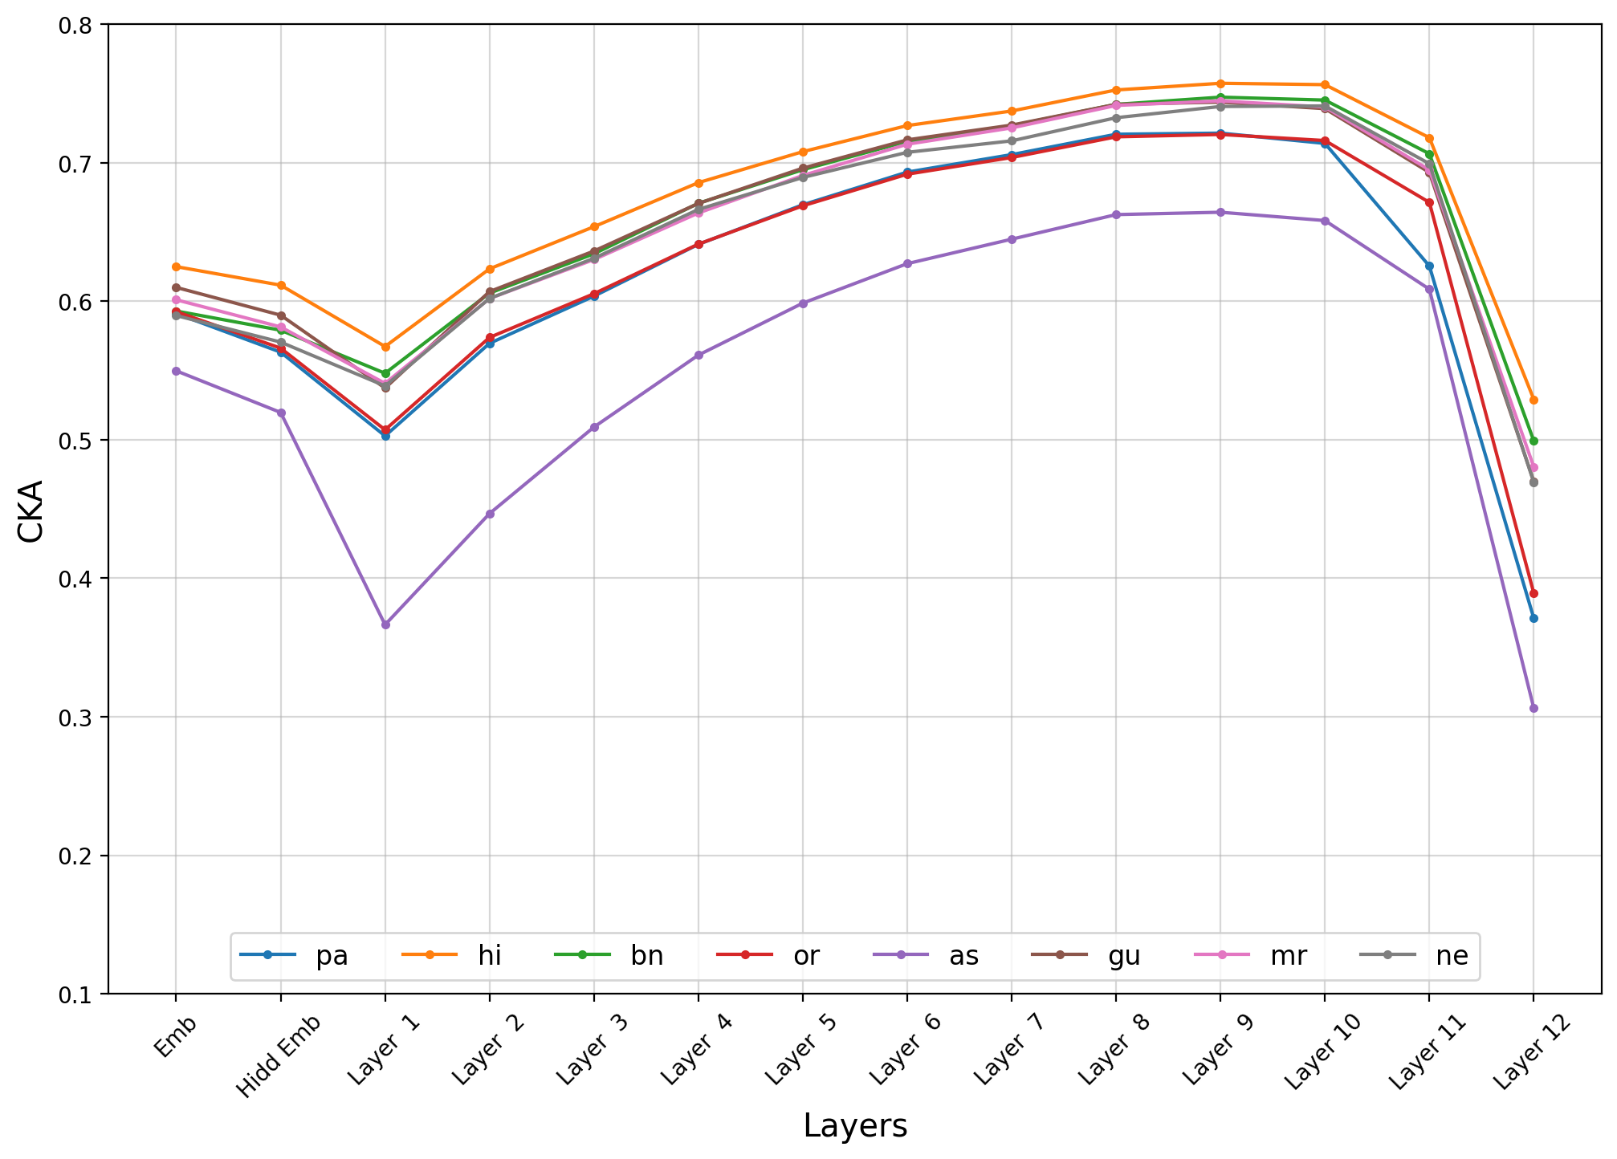
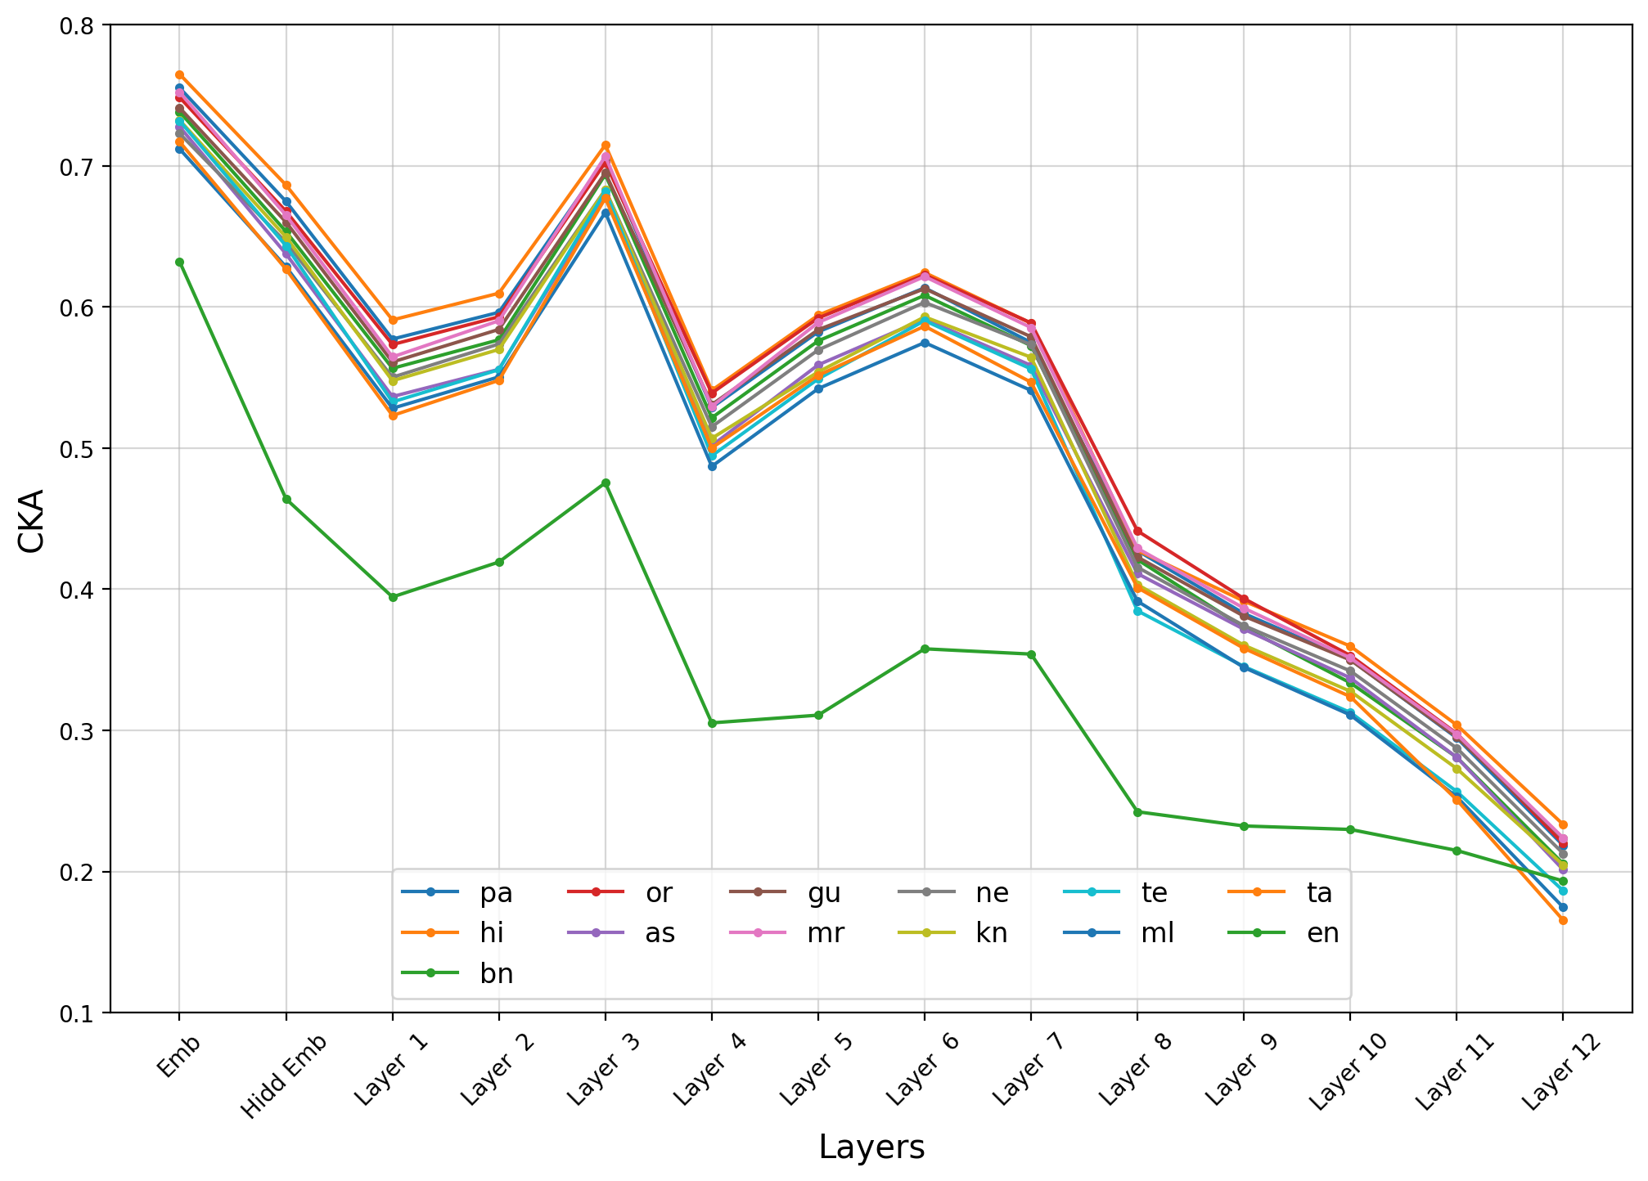
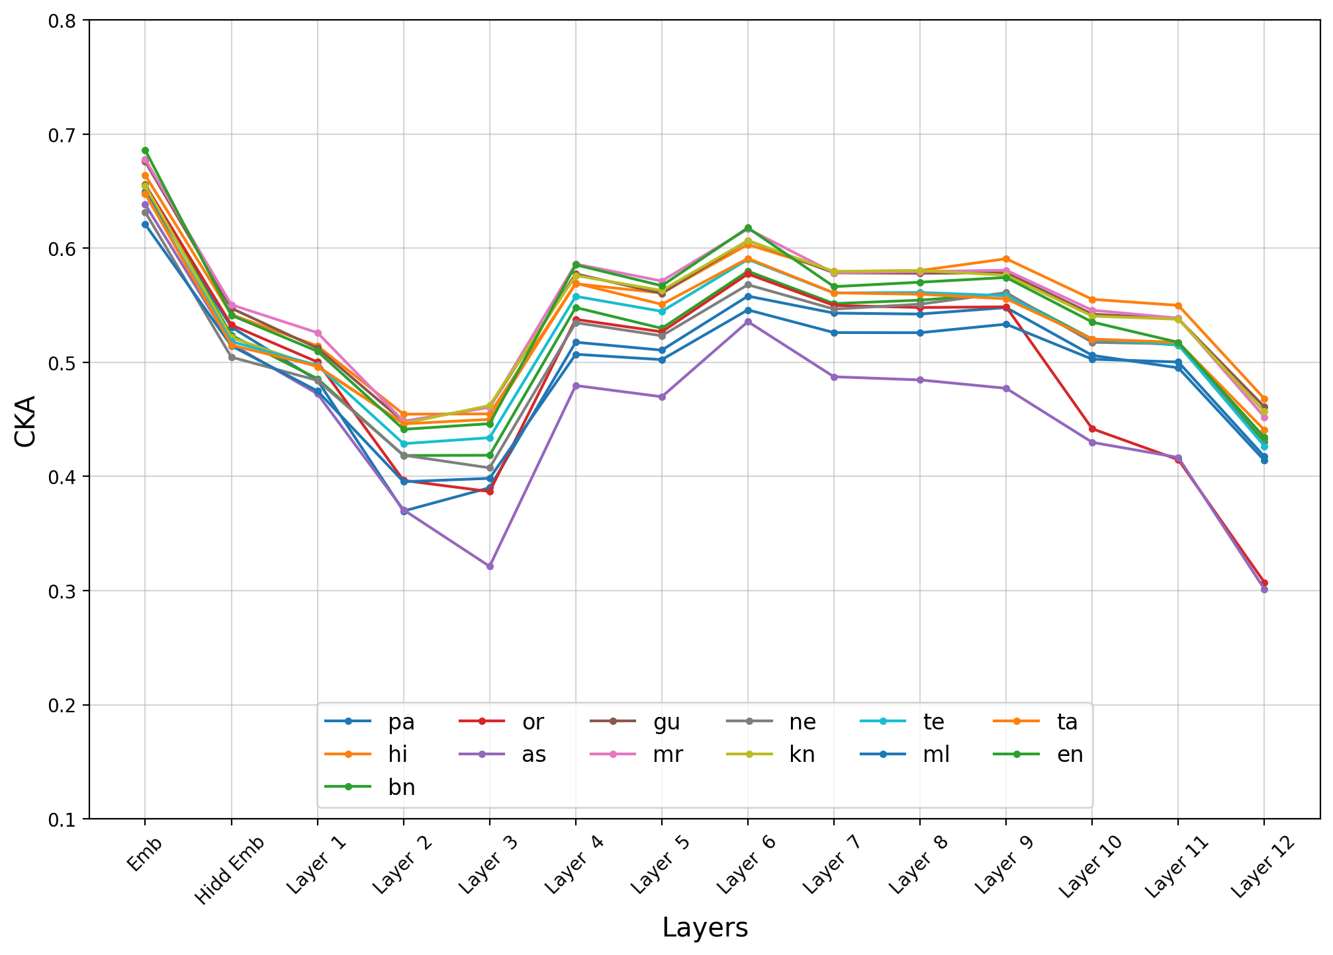
Results: Cross lingual representation
ALBERT Multi-script
ALBERT Uni-script
RemBERT Multi-script
RemBERT Uni-script
Notes:
Finally, we show the results of whether the uni-script model learned better representation compared to the multi-script model. Here, we used the FLORES-101 dataset to get 100 parallel sentences. We then calculated the layer wise average central kernel alignment score between language pairs. Here the main idea is, the lines stay somewhat constant if the embeddings of different languages do not diverge much over the layers.
We can see that this holds true for uni-script models. They start dipping from the 11th layer. However, they stay at a reasonably good value throughout the layers. Whereas, multi-script models have very high fluctuations.

Slide 9
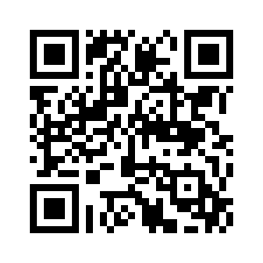

Does Transliteration Help Multilingual Language Modeling?
Ibraheem Muhammad Moosa, Mahmud Elahi Akhter, Ashfia Binte Habib
EACL 2023 Paper ID: 433
Notes:
Thank you so much for listening to our talk. We hope that you find our work useful. For more details please check our paper.

